Slide 1


CORPORATE SOCIAL RESPONSIBILITY
SESSION I

Slide 2

Chapters | Name of the Chapter
Chp No. 1 | Corporate Social Responsibility : The Global Context
Chp No. 2 | Business and its Stakeholders
Chp No. 3 | From Philanthropy to CSR : Historical and Theoretical Perspective
Chp No. 4 | The Business Case for CSR
Chp No. 5 | Developing a CSR Strategy
Chp No.6 | Implementing CSR Strategy
Chp No. 7 | CSR Monitoring and Measurement
Chp No. 8 | Reporting for CSR
Chp No. 9 | Role of Government and Voluntary Codes in CSR
Chp No. 10 | Corporate Ethics and Governance

Slide 3

SESSION DETAILS
Please don’t unmute.
Please use emotes : ☺
Please type your Queries and wait for your turn.
Kindly answer all the Polls or Multiple Choice Question.

Slide 4
Corporate Social Responsibility:
The Global Context
Case Study: TATA 26/11
Globalization and its Impact
Sustainable Development
Role of Business in Sustainable Development
Millennium Development Goals and United Nations Post 2015 Development Agenda
World Bank Group Goals by 2030
Let Sum Up

Slide 5
LEARNING OBJECTIVES
Understand about globalisation and its varying economic and social and environmental impacts.
Know the need for integrating the goal of sustainable development into business.
Understand the Indian Companies Act 2013 and CSR.
Discuss the World Bank Group Goals by 2030.

Slide 6

INTRODUCTION
RESPONSIBILITY
  Responsibility is taking care of your duties.
  Responsibility is answering for your actions.
  Responsibility is accountability.
  Responsibility is trustworthiness.
INDIVIDUAL RESPONSIBILITY?
CORPORATE RESPONSIBILITY?

Slide 7
IMPORTANCE OF CSR FOR INDIA
Rapidly expanding economy and lucrative growth markets for business.
Globalisation, economic growth, investment, and business activity have most dramatic social and environmental impacts in developing countries .
CSR agenda challenges, different from developed world.

Slide 8

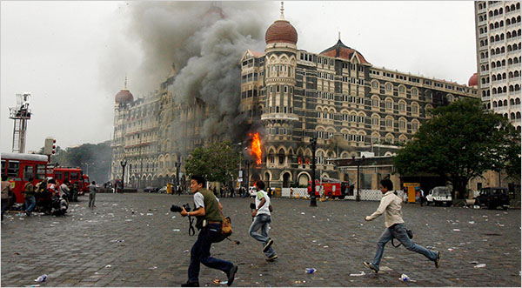
CSR – CASE STUDY

Slide 9
26 -11 / TERROR STRIKES MUMBAI
Eight of the attacks occurred in South Mumbai:
At Chhatrapati Shivaji Terminus,
The Oberoi Trident,
The Taj Mahal Palace & Tower,
Leopold Cafe,
Cama Hospital (A Women And Children's Hospital),
The Nariman House Jewish Community Centre,
The Metro Cinema,
Lane Behind The Times Of India Building And St. Xavier's College.

Slide 10

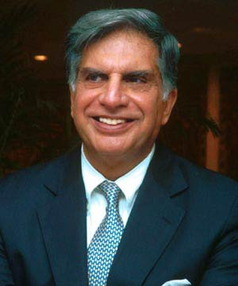
CASE STUDY - TATA
Ratan Tata is the chairman of Indian Hotels who own the Taj Mahal Hotel Mumbai, which was the target of the terrorists.
Hotel President a 5 star property also belongs to Indian Hotels.
What Ratan Tata did for the Mumbai victims....
The following is CSR…

Slide 11
SALUTE TO SHRI RATAN TATA…
All category of employees including those who had completed even 1 day as casuals were treated on duty during the time the hotel was closed.
Relief and assistance to all those who were injured and killed
The relief and assistance was extended to all those who died at the railway station, surroundings including the “Pav- Bhaji” vendor and the pan shop owners.
During the time the hotel was closed, the salaries were sent by money order.
A psychiatric cell was established in collaboration with Tata Institute of Social Sciences to counsel those who needed such help.

Slide 12
SHRI RATAN TATA DIDN’T STOP HERE…
The thoughts and anxieties going on people’s mind was constantly tracked and where needed psychological help provided.
Employee outreach centers were opened where all help, food, water, sanitation, first aid and counseling was provided. 1600 employees were covered by this facility.
Every employee was assigned to one mentor and it was that person’s responsibility to act as a “single window” clearance for any help that the person required.
Ratan Tata personally visited the families of all the 80 employees who in some manner – either through injury or getting killed – were affected.

Slide 13
TATA DOESN’T SAY BYE BYE HERE…
The dependents of the employees were flown from outside Mumbai to Mumbai and taken care off in terms of ensuring mental assurance and peace. They were all accommodated in Hotel President for 3 weeks.
Ratan Tata himself asked the families and dependents – as to what they wanted him to do.
In a record time of 20 days, a new trust was created by the Tata’s for the purpose of relief of employees.
What is unique is that even the other people, the railway employees, the police staff, the pedestrians who had nothing to do with Tatas were covered by compensation. Each one of them was provided subsistence allowance of Rs. 10K per month for all these people for 6 months.

Slide 14
PERSONAL SALUTE FROM EACH ONE OF US…
A 4 year old granddaughter of a vendor got 4 bullets in her and only one was removed in the Government hospital. She was taken to Bombay hospital and several lacs were spent by the Tatas on her to fully recover her.
New hand carts were provided to several vendors who lost their carts.
Tata will take responsibility of life education of 46 children of the victims of the terror.
This was the most trying period in the life of the organisation. Senior managers including Ratan Tata were visiting funeral to funeral over the 3 days that were most horrible.

Slide 15
SETTLEMENT..
The settlement for every deceased member ranged from Rs. 36 to 85 lacs [One lakh rupees translates to approx 2200 US $ ] in addition to the following benefits:
  a. Full last salary for life for the family and dependents;
  b. Complete responsibility of education of children and dependents – anywhere in the world.
  c. Full Medical facility for the whole family and dependents for rest of their life.
  d. All loans and advances were waived off – irrespective of the amount.
  e. Counselor for life for each person

Slide 16
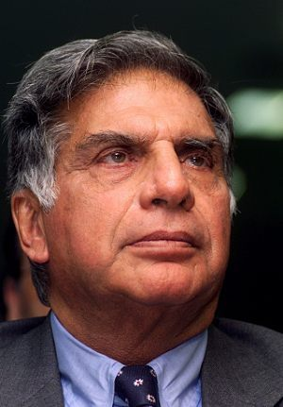
CASE STUDY QUESTION?
Do you think so, What Mr. Ratan Tata did is Right?
Shareholders money is not utilized for business purpose but for community. Explain?
If you had been at the place of Shri Ratan Tata what you would have done?

Slide 17

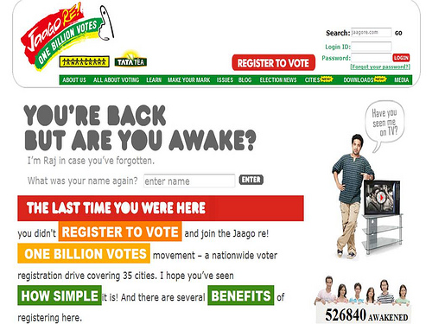
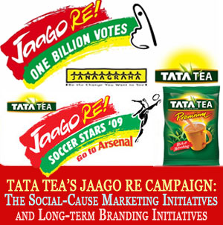
TATA TEA – JAAGO RE….

Slide 18
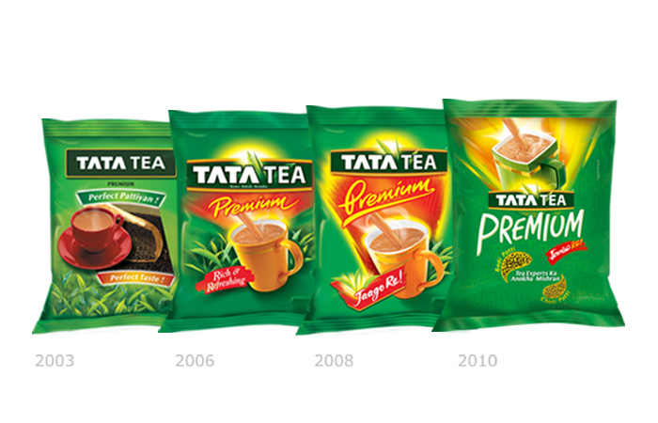
TATA TEA
The latest “Badi Patti/Chhoti Patti” message signifies the richness of tea leaves, while at the same time, it satirically takes a shot at bribery which is prevalent in India.
The current campaign is an extension of the current campaign based around the social (awakening) theme of “Jaago re”.

Slide 19
AND LET SEE WHAT’S NOT CSR?
Everytime a new scam is known, the sum of the scam is in multiples of earlier scams.
Bofors ?? 25 years? “ ONLY” 60 cr
4000 cr. Harshad
7800 cr. Satyam fraud
Madhu Koda – 4000 cr (slight decrease)
20000 cr. – Telgi fake stamp.
How nice it would be if at least part of it is unearthed and some of our deficit financing can be eased out.

Slide 20
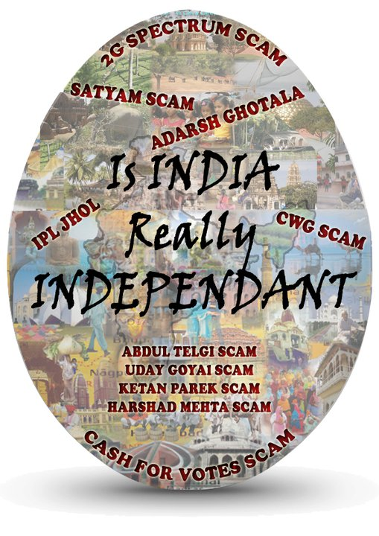

Slide 21
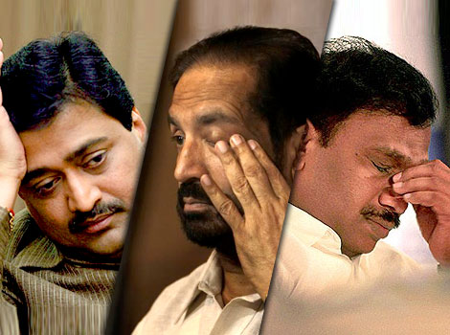
TOP SCAMS
2G Spectrum Scam – 1.76 lakh Crores
CWG Scam – 70,000 Crores spent
Telgi Scam – 20,000 Crores
Satyam – 14,000 Crores
BOFORS - $16 Million
Fodder Scam – 900 Crores
Hawala scandal - $ 18 Million as Bribery
IPL Scam
Harshad Mehta and Ketan Parekh – 4000 Crores +1000 Crores

Slide 22

INTRODUCTION
Globalization is both the cause and effect of a stream of economic, social, political, environmental and technological changes . It has given rise to the concept of “the flat world” or a borderless world with the Business models getting increasingly global.
Corporate Social Responsibility ( CSR) is closely linked with the principles of Sustainable Development, which argues that enterprises should make decisions based not only on financial factors such as profits or dividends, but also based on the immediate and long-term social and environmental consequences of their activities.
CSR goes beyond charity and requires that a responsible company take into full account its impact on all stakeholders and on the environment when making decisions. This requires the company to balance the needs of all stakeholders with its need to make a profit and reward shareholders adequately.

Slide 23
GLOBALIZATION
“A process of interaction and integration among the people, companies and governments of different countries, a process driven by international trade and investment and aided by information technology. This process affects the environment, culture, political systems, economic development and prosperity, and physical human well being in societies around the world”
- Carnegie Endowment for International Peace
“Globalization on one hand is seen as an irresistible and benign force for delivering economic prosperity to people throughout the world and on the other end, it is blamed as a source of all contemporary ills”
- International Labor Organization

Slide 24

EXAMPLE
Assume that you are a mango farmer and you grow very good quality mangoes .
Obviously, your fruit is highly appreciated in India, but you also know that you shall get a better value in US.
So the network of communication and execution that allows you to sell your fruit in US is basically, the phenomenon of globalization.

Slide 25
TRUE OR FALSE
Liberalization leads to Globalization
In the Year 1991, under whose leadership the Economic Liberalization was initiated?

Slide 26
LARGE NUMBER OF MULTINATIONALS HAVE MOVED TO INDIA POST GLOBALIZATION
Beverages (Coke, Pepsi)
Fast Foods (McDonalds, Pizza Hut, KFC)
Coffee (Barista)
Sports Wear & Goods (Nike, Adidas)
Apparels & Garments (Levis, Reid & Taylor)
Cosmetics (Revlon, Oriflamme, Maybellene)
Two/Four Wheelers (Honda, Toyota, Suzuki, Hyundai, General Motors, Ford, Mercedes)
Computers (Dell, HP, IBM, Samsung, Sony, Compaq)
White Goods (LG, Samsung, GE)
Pharmaceuticals (US, Europe, Britain)
Music (Sony, BMG, Warner)
Entertainment Channels (Star, National Geographic, Discovery, Sony)
Sourcing (IKEA, Adidas, Nike, many others)

Slide 27
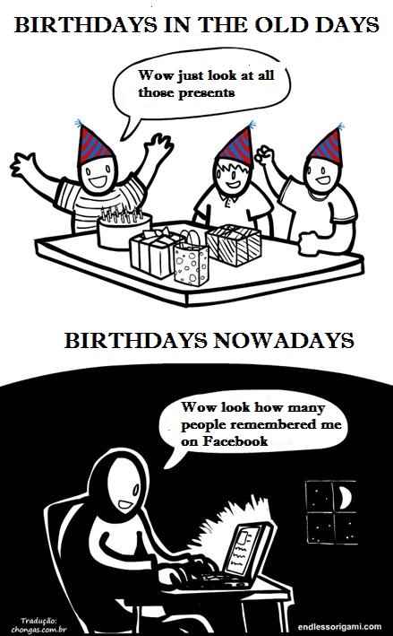
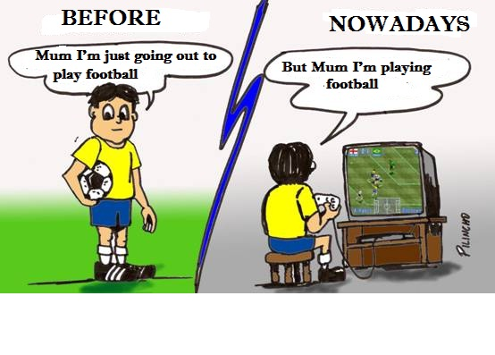
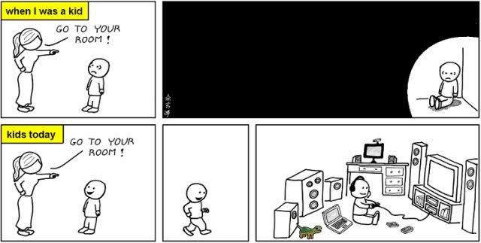
SOCIAL IMPACT

Slide 28
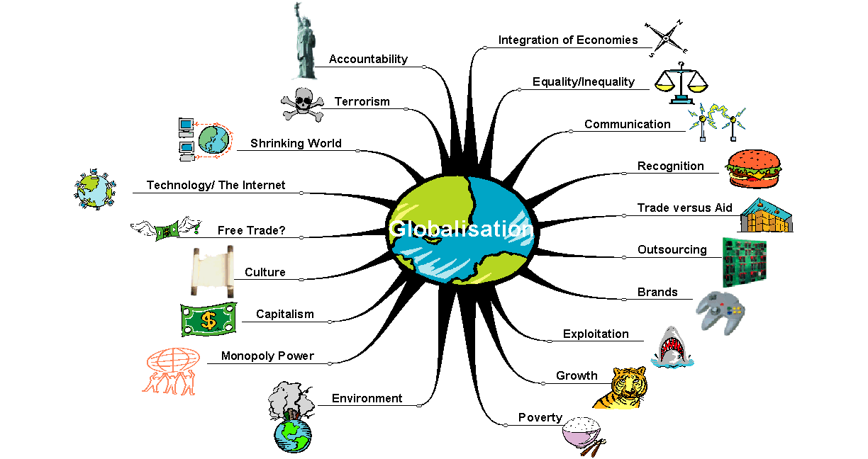
Globalisation could involve all these things!

Slide 29
POSITIVE IMPACT OF GLOBALIZATION
Goods and people are transported with more easiness and speed
Free trade between countries increases
Global mass media connects all the people in the world
As the cultural barriers reduce, the global village dream becomes more realistic
The interdependence and relation of the nation-states increases
Outsourcing reduces the cost
Access to the latest technology
Promotion of healthy competition

Slide 30
GLOBALISATION AND ITS IMPACT: ECONOMIC IMPACTS
Narrowing of gap between economic growth rates of developed and developing countries.
Liberalisation and expansion of international trade led to increase in FDI
Change in governance structure of global financial system - Private actors such as banks, hedge funds, equity funds and rating agencies.
Business models are increasingly getting global.
Integration of economies by means of rapid advances in the ICT.

Slide 31
GLOBALISATION AND ITS IMPACT: SOCIAL IMPACTS
Rise in per capita income, GDP etc. in emerging economies but also rising economic inequality
Unskilled, illiterate and asset-less labour remain , so persistent poverty - Rural and informal economies,
Richest 0.5 percent of global adults hold over a third of the world’s wealth.
Relative poverty increased in majority of the countries
Corporate scandals, manipulations and over extension of credits to unstable local banks / firms resulting in increasing financial crisis.

Slide 32
GLOBALISATION AND ITS IMPACT: ENVIRONMENTAL IMPACTS
Degradation of natural environment.
Ecological imbalances and climate change due to :
  Increase in trade
  Larger corporations with centralised distribution
  Poor pollution control mechanisms of MNCs in foreign markets
  Extractive industries using natural resources non-judiciously.

Slide 33
SELECT A RIGHT OPTION
Globalization impacts:
All of the below
Cultures
Environment
Political Systems

Slide 34
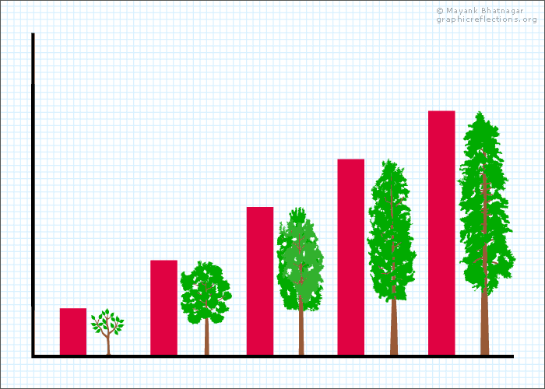
SUSTAINABLE DEVELOPMENT
for the generations to come…

Slide 35
SUSTAINABLE DEVELOPMENT
Sustainable development is a pattern of resource use that aims to meet human needs while preserving the environment so that these needs can be met not only in the present, but also for future generations.
“Development that meets the need of the present without compromising the ability of future generations to meet their own needs”
- Brudtland commission

Slide 36
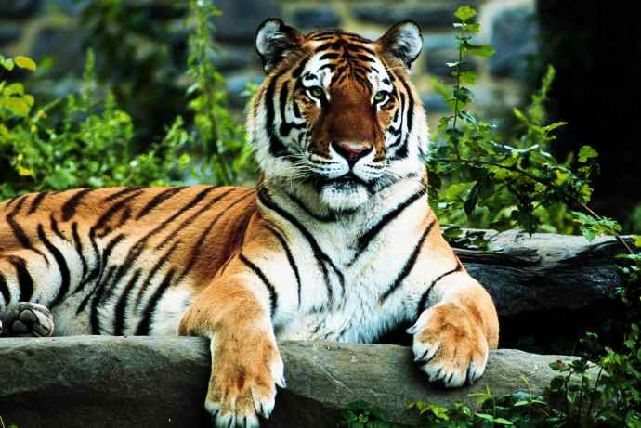
WHY SUSTAINABLE DEVELOPMENT?

Slide 37

WHY SUSTAINABLE DEVELOPMENT?

Slide 38
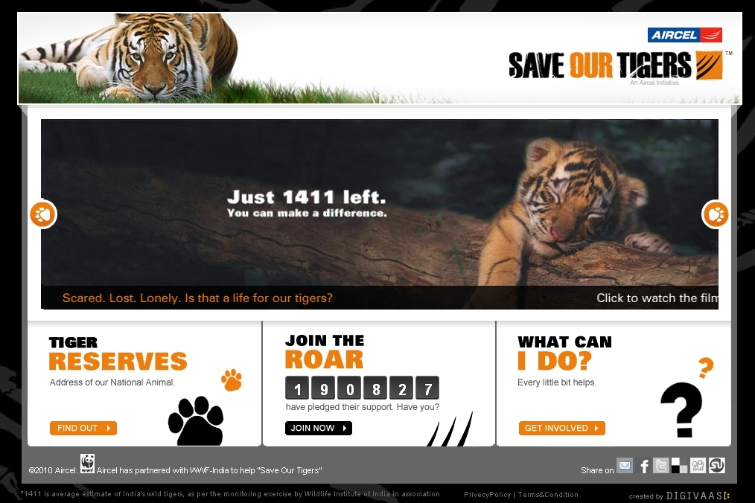

Slide 39
ROLE OF BUSINESS IN SUSTAINABLE DEVELOPMENT
Sustainable is a broad concept that balances the need for economic growth with environmental protection and social equity.
Sustainability requires a balancing of the triple bottom line opportunities, risks and implications of action.
The idea behind sustainability is that the businesses can add value to society in three ways:
  Economic
  Social
  Environmental

Slide 40
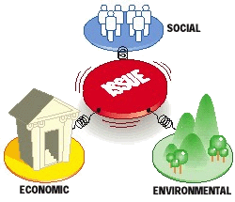
THREE INGREDIENTS

Slide 41
TRUE OR FALSE
The aim of sustainable development is to reduce relative poverty.
TRUE
FALSE

Slide 42
SELECT A RIGHT OPTION:
Which element is not required to have the Balanced Sustainable Development?
People
Planet
Price
Profit

Slide 43

MILLENNIUM DEVELOPMENT GOALS
Lets make this planet a better place to live…

Slide 44
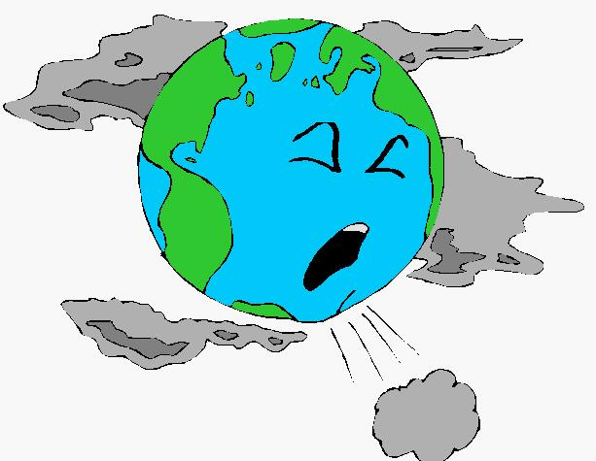
“We now face the ultimate management challenge, that of managing our own future as species”
- Maurice Strong
Secretary General of the World Summit

Slide 45
MILLENNIUM DEVELOPMENT GOALS
“Government alone cannot deal with the issue of Sustainable Development” – Reason on next slide
Collaborative partnership is essential.
To address the issue of sustainable development and poverty Millennium Development Goals were formed.
In September 2000, World leaders belonging to the government, businesses and NGO’s in the gathering at the United Nations adopted eight specific, measurable, time bound targets called as Millennium Development Goals.

Slide 46

CORPORATE DOMINANCE IN GLOBAL ERA
51 of the world's 100 largest economies are corporations (not countries, as one might expect)
Royal Dutch Shell's revenues are greater than Venezuela's Gross Domestic Product.
WalMart’s revenues are bigger than Indonesia’s GDP.
General Motors is roughly the same size as Ireland, New Zealand and Hungary combined.
Walmart, Royal Dutch Shell, ExxonMobil, BP, Toyota and Japan Post -- combined last year for a dollar-value revenue of $2.34 trillion. This is about the same total, though calculated by different means and not quite comparable, as the United Kingdom's $2.22 trillion GDP.

Slide 47
COUNTRY AND COMPANY
World GDP, 2010 | $61.78 trillion
1. United States | $14.80
2. China | $5.36
3. Japan | $5.27
4. Germany | $3.33
25. Taiwan | $0.42
26. Walmart Stores | $0.41
33. Thailand | $0.30
34. Royal Dutch/Shell | $0.29
35. ExxonMobil | $0.29
36. United Arab Emirates | $0.25
37. BP | $0.25
45. Malaysia | $0.21
46. Toyota | $0.20
47. Japan Post | $0.20
51. Singapore | $0.19
52. Sinopec | $0.19
53. State Grid (China) | $0.19
55. Philippines | $0.18
56. AXA (France) | $0.17
57. Romania | $0.17
60. New Zealand | $0.14

Slide 48
IF COMPANIES WERE COUNTRIES

Slide 49

Yahoo is bigger than Mongolia
Mongolia's GDP: $6.13 billion
Yahoo's Revenue: $6.32 billion
Yahoo would rank as the world's 138th biggest country.

Slide 50
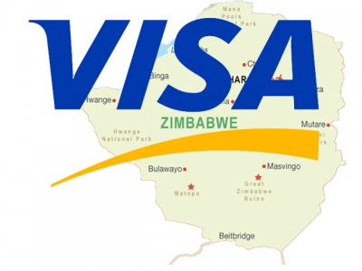
Visa is bigger than Zimbabwe
Zimbabwe's GDP: $7.47 billion
Visa's Revenue: $8.07 billion
Zimbabwe would rank as the world's 133rd biggest country.

Slide 51
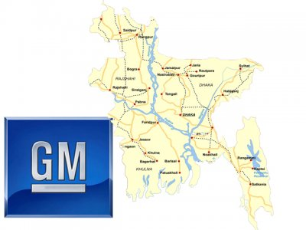
General Motors is bigger than Bangladesh
Bangladesh's GDP: $104.92 billion
GM's Revenue: $135.59 billion
GM would rank as the world's 58th biggest country.

Slide 52

General Electric is bigger than New Zealand
New Zealand's GDP: $140.43 billion
GE's Revenue: $151.63 billion
GE would rank as the world's 52nd biggest country.

Slide 53

Walmart is bigger than Norway
Norway's GDP: $414.46 billion
Walmart's Revenue: $421.89 billion
Norway would rank as the world's 25th biggest country.

Slide 54
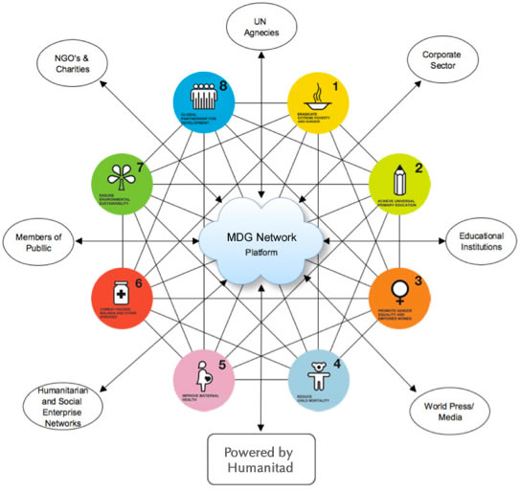
FORMATION
189 member states and 23 International Organizations have agreed to achieve MDG’s by 2015.
It required co-operation from developed countries in respect of:
  Trade
  Development assistance
  Debt Relief
  Access to essential medicines
  Technology Transfer

Slide 55
ISSUES TO BE COVERED UNDER MDG’S:
Inadequate Incomes
Widespread hunger
Gender Inequality
Environmental Deterioration
Lack of Education
Health care and clean water

Slide 56

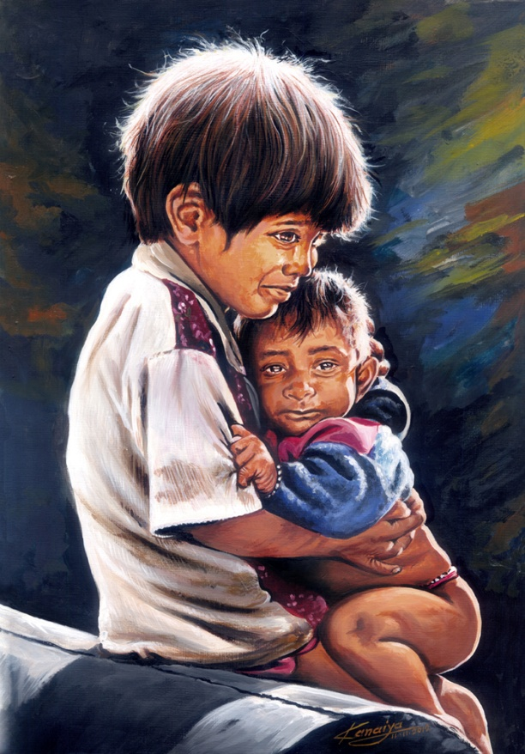

STORY OF RAJU

Slide 57



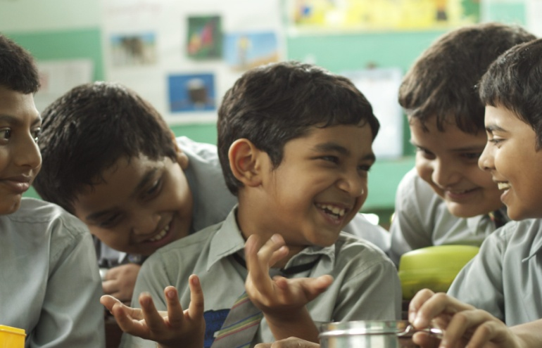
STORY OF RAJU

Slide 58
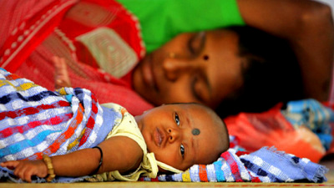
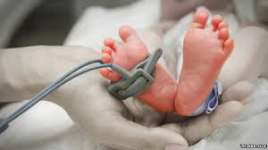
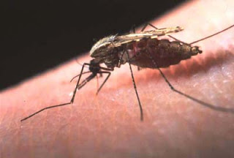
STORY OF RAJU

Slide 59

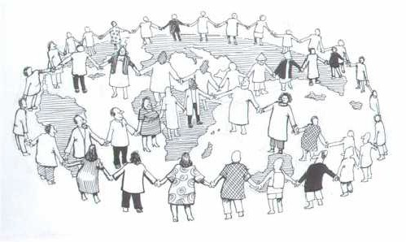
STORY OF RAJU

Slide 60

MILLENNIUM DEVELOPMENT GOALS
GOAL 1: Eradicate extreme Poverty and Hunger
GOAL 2: Achieve Universal Primary Education
GOAL 3: Promote gender Equality and Empower Women
GOAL 4: Reduce child mortality
GOAL 5: Improve maternal health
GOAL 6: Combat HIV/AIDS, Maleria and other Diseases
GOAL 7: Ensure Environmental Sustainability
GOAL 8: Develop a Global Partnership for development

Slide 61
MILLENNIUM DEVELOPMENT GOALS AND UN POST 2015 DEVELOPMENT AGENDA: INDIA AND STATUS OF SELECTED MDGS
Target No. | Target Description | Progress Signs
1. | Halve, between 1990 and 2015, proportion of population below national poverty line | Δ
2. | Halve, between 1990 and 2015, proportion of people who suffer from hunger | Θ
3. | Ensure that by 2015 children everywhere, boys and girls alike, will be able to complete a full course of primary education | ΔΔ
4. | Eliminate gender disparity in primary and secondary education, preferably by 2005, and in all levels of education no later than 2015 | Δ
5. | Reduce by two-thirds, between 1990 and 2015, the under-five mortality rate | ΘΔ
6. | Reduce by three quarters, between 1990 and 2015, the maternal mortality ratio | ΘΔ
7. | Integrate the principles of sustainable development into country policies and programs and reverse the loss of environmental resources | ΔΔ
8. | Halve, by 2015, the proportion of people without sustainable access to safe drinking water and basic sanitation | ΔΘ
Δ : Moderately/almost nearly on track considering all indicators
Θ : Slow/almost off-track considering all indicators
ΔΔ : On-track or fast considering all indicators

Slide 62
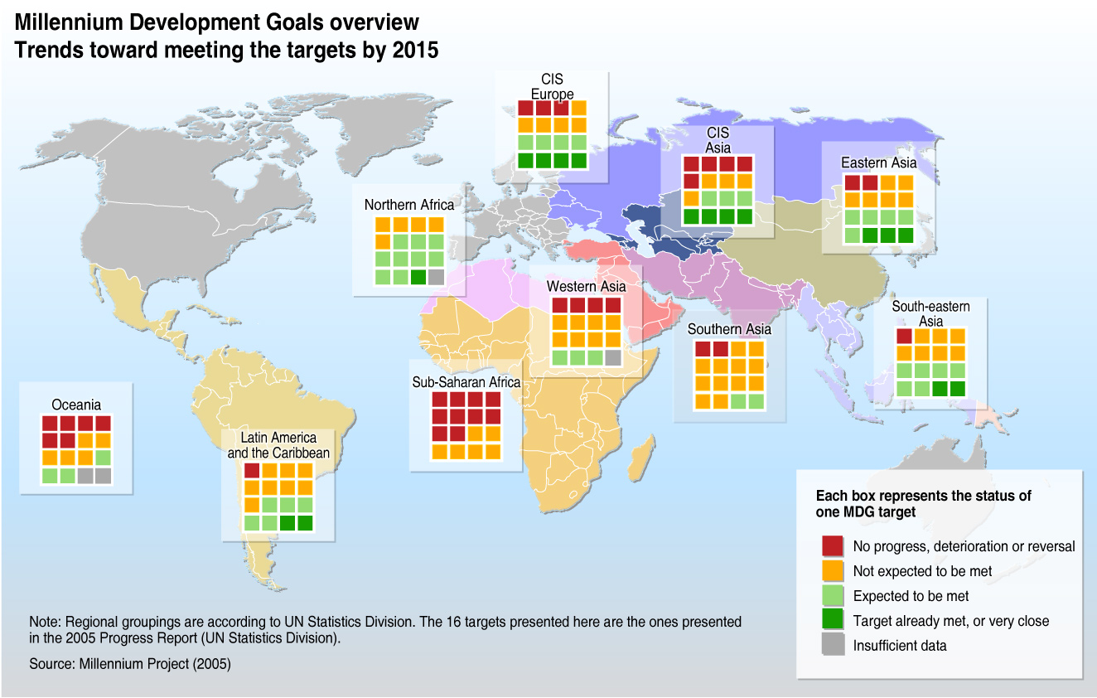

Slide 63
SELECT A RIGHT OPTION
Which of these is not a MDG?
Promote Education
Reduce Gender Inequality
Reduce Child Labour
Reduce Infant Mortality

Slide 64

Millennium Development Goals and UN Post 2015 Development Agenda : UN Post 2015 Development Agenda
Global Compact positioned to convey business perspective to the post-2015 development process since Rio+20 Corporate Sustainability Forum in June 2012
Business and the Global Compact to help shape the future priorities of the UN.
Will help Global Compact achieve its mission – to make corporate sustainability a transformative force in achieving a shared, secure and sustainable future.
Member States discussing new set of Sustainable Development Goals (SDGs), to complement or replace the MDGs.

Slide 65
Millennium Development Goals and UN Post 2015 Development Agenda: Indian Companies Act 2013 And CSR
Mandated that companies having net worth of Rs.500 crore or more, or turnover of Rs.1,000 crore or more, or net profit of Rs.5 crore or more during a year
  To formulate a CSR policy
  To ensure that it spends at least 2 percent of its average net profits during the immediately preceding three financial years on CSR activities as may be specified by the company legislation.
First time in the world that a country has mandated expenditure for public good.
Mandatory CSR will force companies to be conscious of their social responsibilities.

Slide 66
World Bank Group Goals by 2030
World Bank intends integrating goals of business growth with economic and social development.
Approach of World Bank referred to as Washington Consensus.
The two goals :
End extreme poverty: The percentage of people living with less than $1.25 a day to fall to no more than 3 percent globally by 2030.
Promote shared prosperity: Foster income growth of the bottom 40% of the population in every country.
Requires promoting environmental, social, and fiscal sustainability.
Secure long-term future of planet/ its resources for future generations
Sustained social inclusion and limit economic debt of future generations.

Slide 67
World Bank Group Goals by 2030 :
India and World Bank Group Country Partnership Strategy
The World Bank Groups New Country Partnership Strategy (CPS) for India (2013-2017) to lend $3 billion to $5 billion each year over the next four years.
Strategy will focus on three key areas: integration, transformation and inclusion.
  Integration – Improving infrastructure
  Transformation – By 2031, 600 million people will live in India’s cities, engagement on the rural-urban transformation
  Inclusion –Focus on human development and policies that make growth inclusive, in strengthening nutrition and education.

Slide 68
LETS SUM UP
Impact of globalisation on society largely from technological and social change.
Ecological and social challenges in the 21st century cannot be tackled by yesteryear’s rule of governance.
World is interdependent where problems of poverty, unemployment, inequality, environmental degradation and social disintegration are concerned.
Trend worldwide to tackle problems adopting collaborative and consultative models - Government, Businesses and Non-government initiatives

Slide 69
CORPORATE SOCIAL RESPONSIBILITY
SESSION I
Prof. Deepak R. Gupta
(O)022 - 42355523
deepak.gupta@nmims.edu

Slide 70
Chapters | Name of the Chapter
Chp No. 1 | Corporate Social Responsibility : The Global Context
Chp No. 2 | Business and its Stakeholders
Chp No. 3 | From Philanthropy to CSR : Historical and Theoretical Perspective
Chp No. 4 | The Business Case for CSR
Chp No. 5 | Developing a CSR Strategy
Chp No.6 | Implementing CSR Strategy
Chp No. 7 | CSR Monitoring and Measurement
Chp No. 8 | Reporting for CSR
Chp No. 9 | Role of Government and Voluntary Codes in CSR
Chp No. 10 | Corporate Ethics and Governance

Slide 71
BUSINESS AND ITS STAKEHOLDERS
Business and Society
Business organisation and Systems
From Shareholder to Stakeholder Theory
Stakeholder Concept
Typology of stakeholders and their influence
Stakeholder Engagement
Dynamic Environment of Business
Let Sum Up

Slide 72
LEARNING OBJECTIVES
Know about a meaningful coexistence of business and society
Understand the need and responsibility to create a conducive environment for business
Understand stakeholder typologies and their significance in business
Underline the role of communication in Stakeholder Management
Appreciate the need for stakeholder contribution in decision making
Recognise the need for effective communication in CSR initiatives

Slide 73
HOW IS SOCIETY DEPENDENT ON BUSINESS?

Slide 74
BUSINESS AND SOCIETY
Business dependent on the society for sustaining itself
Gets manpower, raw materials, financial and other resources from the society.
Needs the larger society to facilitate exchange of finished products and services.
In return, businesses
  Contributes to the GDP of the nation
  Provide employment
  Aid in infrastructure development
  Improve the quality of life of people.
Understanding impact of its decisions on the larger society will help to manage interdependencies.

Slide 75
EMPLOY PEOPLE
Provide people with :
income for living expenses
source of satisfaction and achievement
sense of identity and pride.

Slide 76

GOOGLE OFFICE ZURICH: THEY JUST DON’T EMPLOY

Slide 77

GOOGLE OFFICE ZURICH

Slide 78
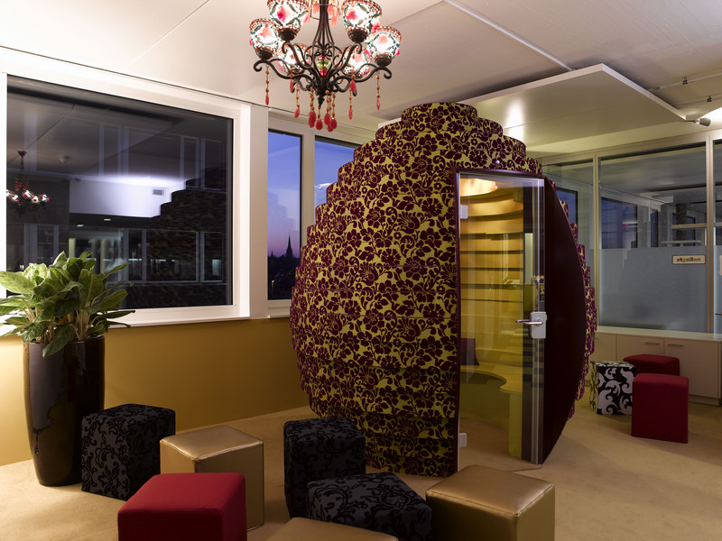
GOOGLE OFFICE ZURICH

Slide 79
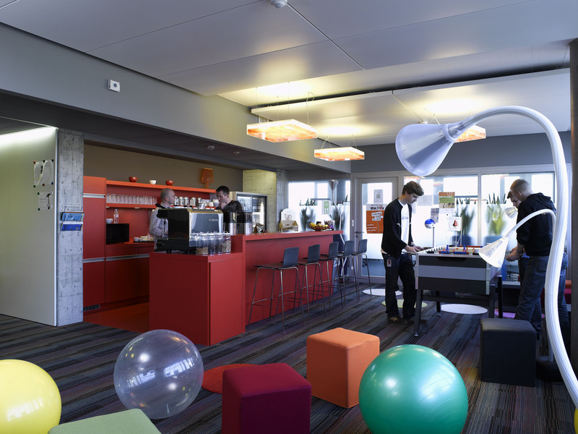
GOOGLE OFFICE ZURICH

Slide 80
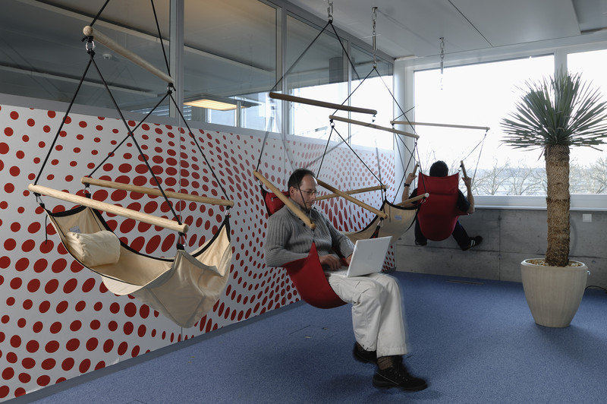
GOOGLE OFFICE ZURICH

Slide 81
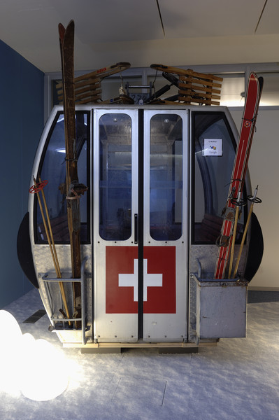
GOOGLE OFFICE ZURICH

Slide 82
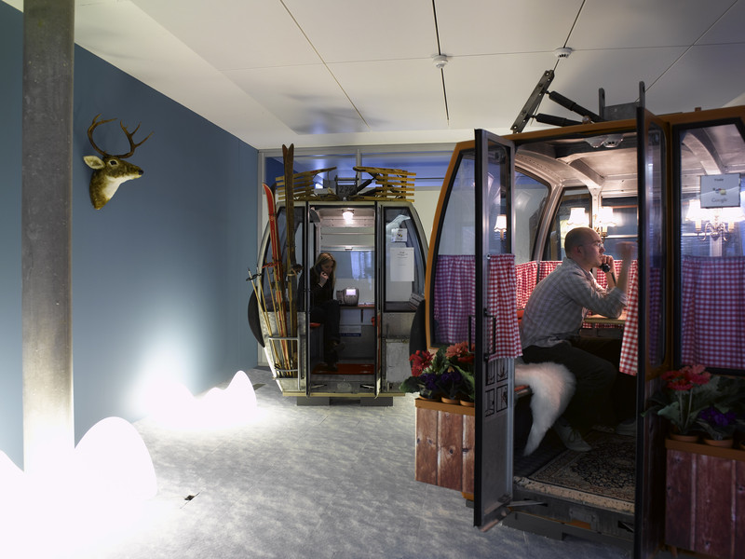
GOOGLE OFFICE ZURICH

Slide 83
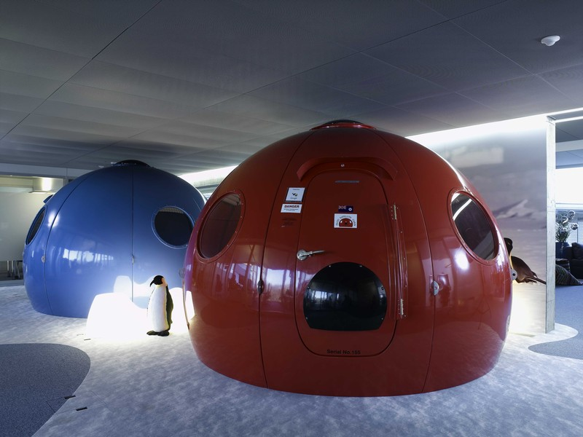
GOOGLE OFFICE ZURICH

Slide 84
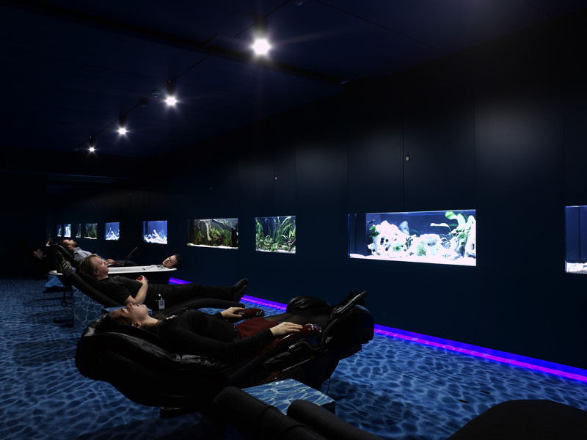
GOOGLE OFFICE ZURICH

Slide 85
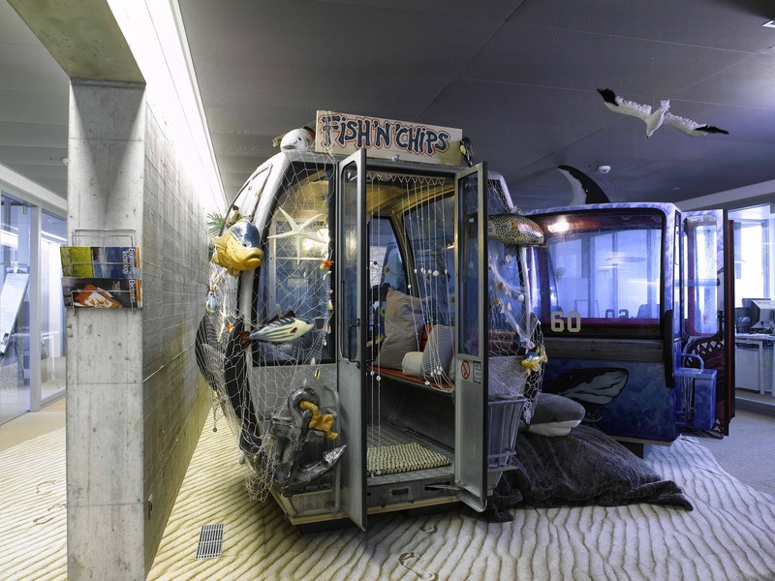
GOOGLE OFFICE ZURICH

Slide 86
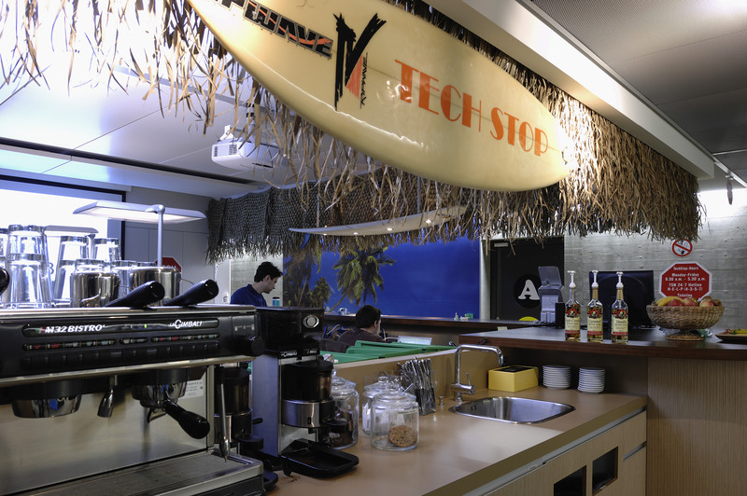
GOOGLE OFFICE ZURICH

Slide 87
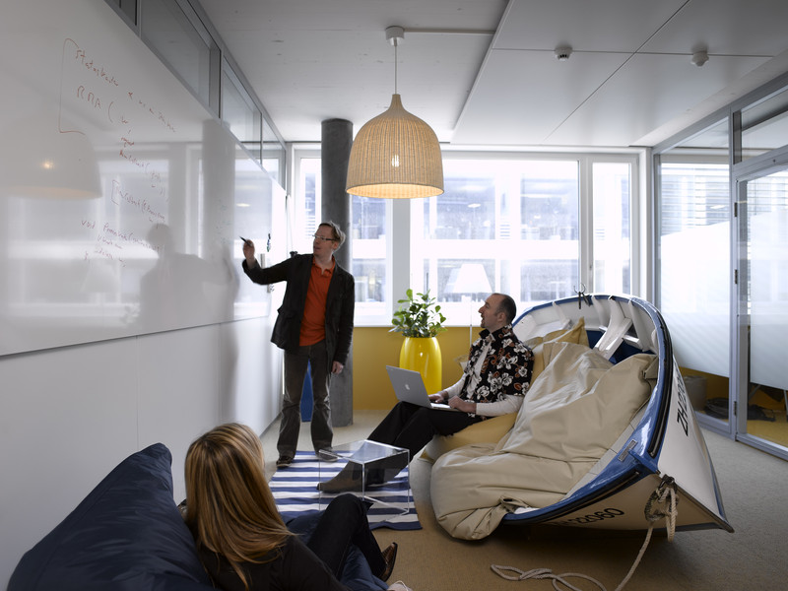
GOOGLE OFFICE ZURICH

Slide 88
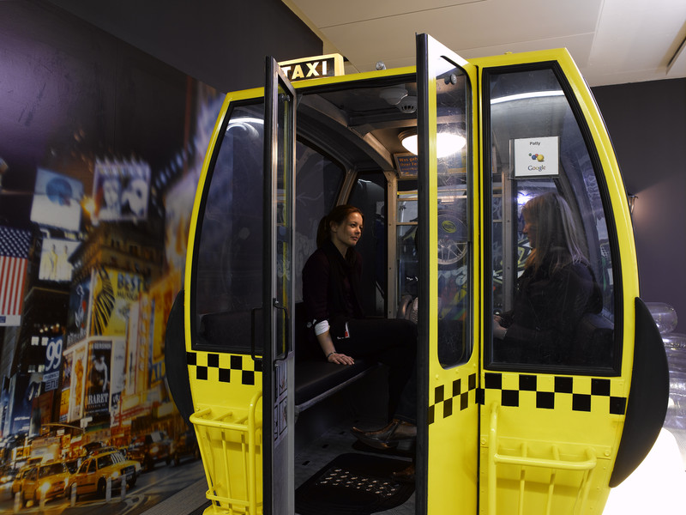
GOOGLE OFFICE ZURICH

Slide 89
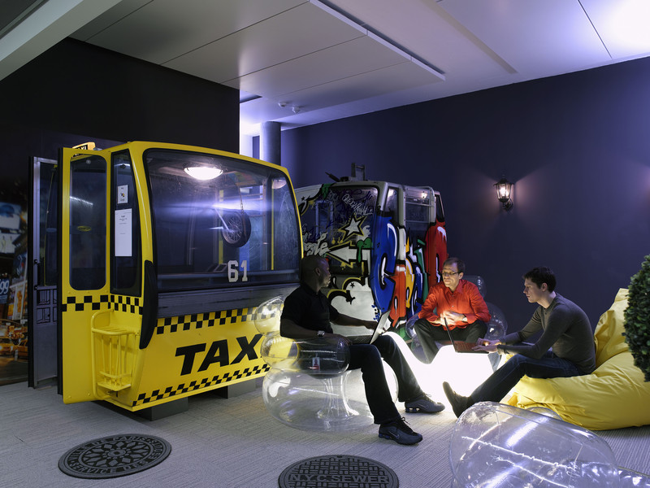
GOOGLE OFFICE ZURICH

Slide 90
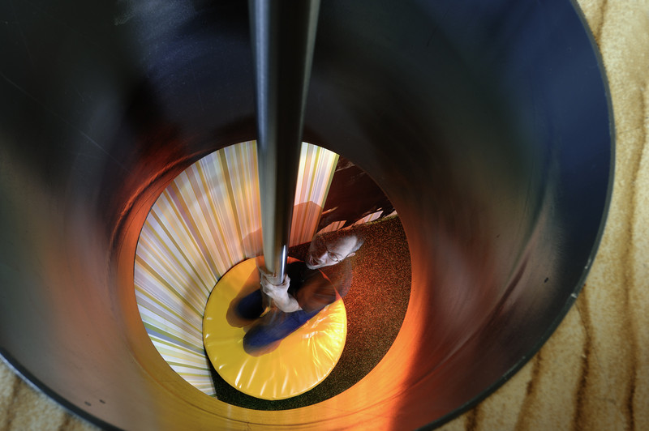
GOOGLE OFFICE ZURICH

Slide 91
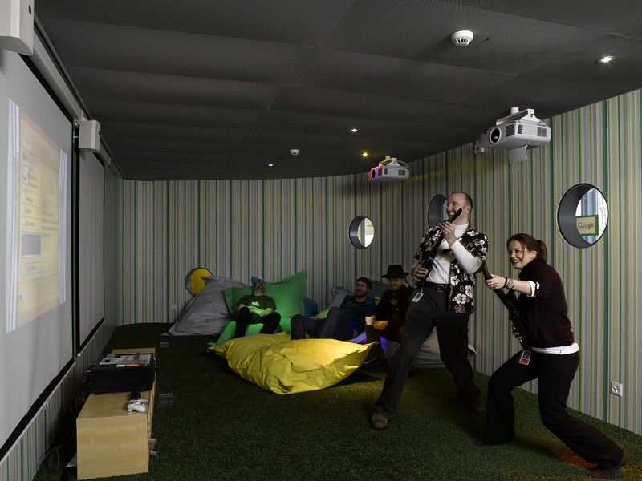
GOOGLE OFFICE ZURICH

Slide 92
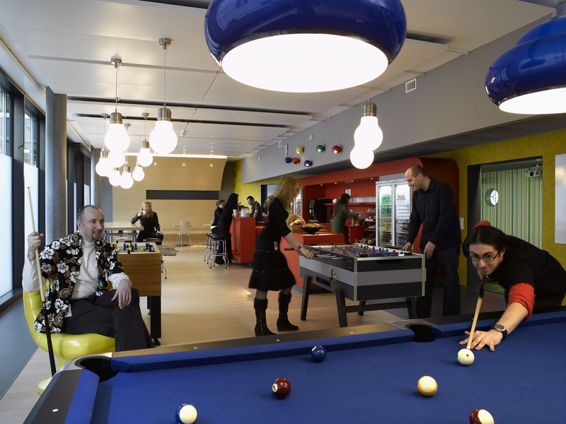
GOOGLE OFFICE ZURICH

Slide 93

GOOGLE OFFICE ZURICH

Slide 94
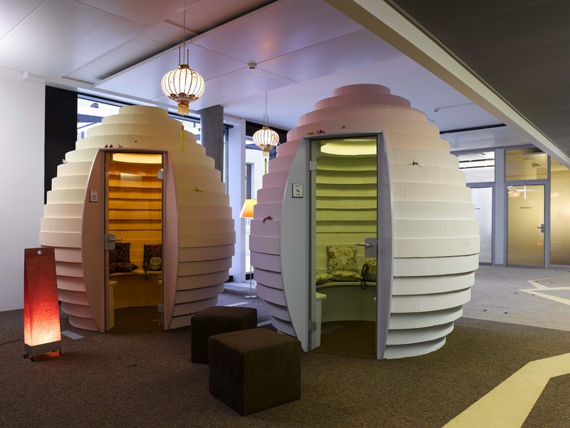
GOOGLE OFFICE ZURICH

Slide 95
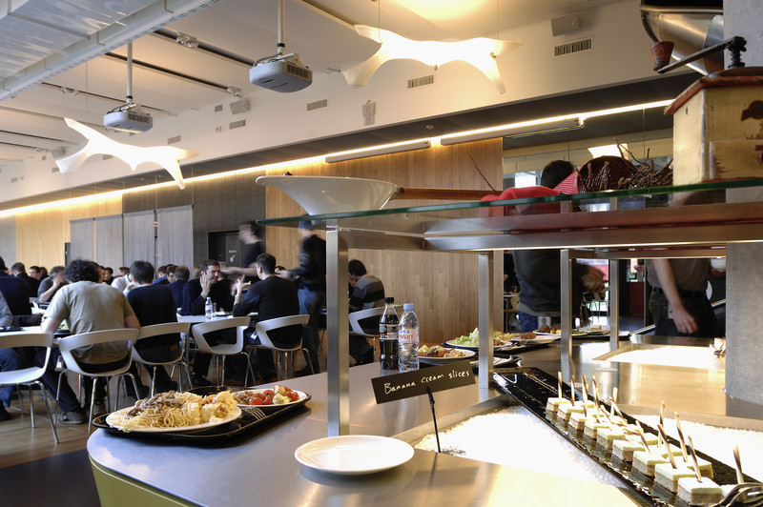
GOOGLE OFFICE ZURICH

Slide 96
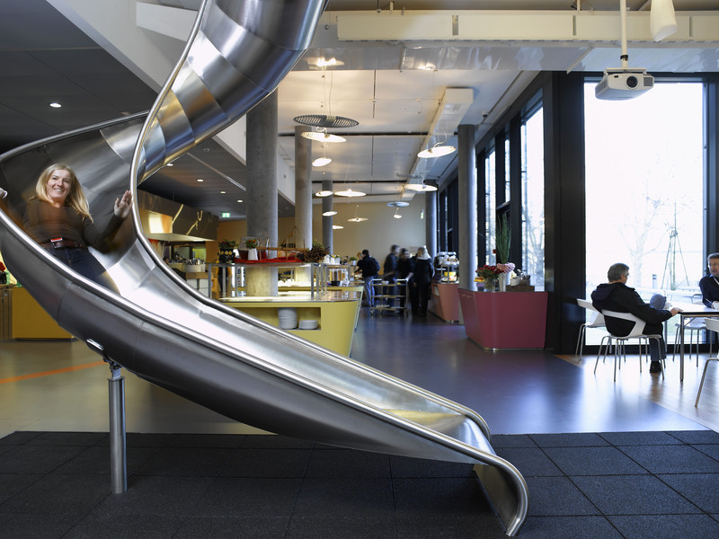
GOOGLE OFFICE ZURICH

Slide 97

TECHNOLOGICAL CHANGE AND INNOVATION
Competition delivers products which are better, cheaper or more convenient
Technology is the key to
  lower costs
  improved quality or
  the delivery of goods/services more quickly

Slide 98

CHOICE
offered to consumers when business sector is healthy and diverse
where you work, eat, shop and what you buy
allows people to specialise in what they do and interests pursued

Slide 99
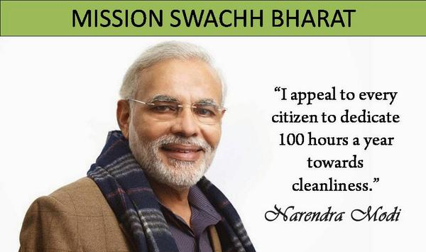
SOCIAL ROLE
Helping society in achieving 3P
Helping government to achieve dream

Slide 100
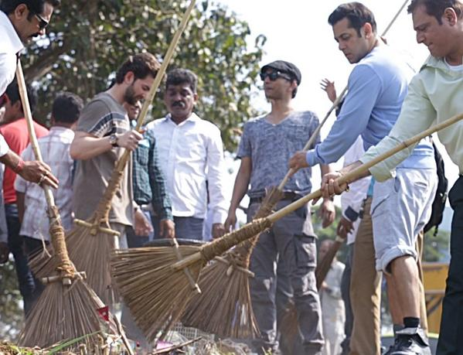
SWACHHA BHARAT

Slide 101
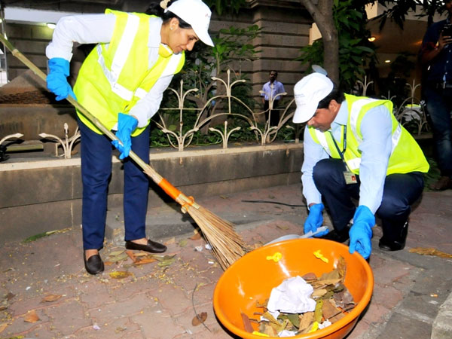
SWACHHA BHARAT – CHANDA KOCHHAR MD, ICICI

Slide 102
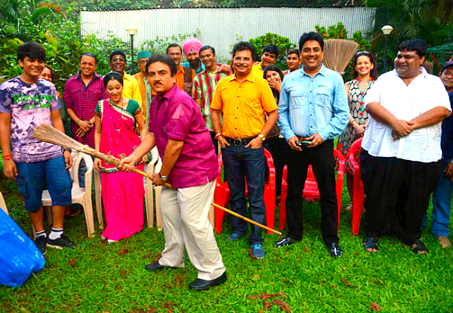
SWACHHA BHARAT - TMKUC

Slide 103
HOW IS BUSINESS DEPENDENT ON SOCIETY?

Slide 104


CUSTOMERS

Slide 105

NATURAL RESOURCES

Slide 106

LAWS

Slide 107
BUSINESS AND SOCIETY
The collection of private,
commercially oriented organizations
0
Business
A broad group of people and other
organizations, interest groups,
a community, a nation.
Society
Business and society interrelate in a macroenvironment as stakeholders.

Slide 108
BUSINESS ORGANIZATION AS SYSTEMS
As per systems theory all organizations are open to and interact with their external environment.
Emphasizes ways in which organized systems (human and non-human) respond to cope with significant changes in their external environments so as to maintain their basic structures intact.
For business management discipline, the system’s concept implies that business firms are embedded in a broader social structure (external environment) with which they constantly interact.

Slide 109
FROM SHAREHOLDER THEORY TO STAKEHOLDER THEORY
Ownership Theory of the Firm - Maximize the interests of the firm’s shareholders; that is, to maximise profits.
R. Edward Freeman propagated the Stakeholder Theory.
Stakeholder theory –
  Managers to serve the interests of all who have a ‘stake’ in the firm.
  Stakeholders include shareholders, employees, suppliers, customers and the communities in which the firm operates
  Treats the firm as a social creation that must operate for benefit of society.

Slide 110
STAKEHOLDERS CONCEPT
The main stakeholders in businesses are:
Shareholders
Management and employees
Customers
Suppliers
Banks and other financial organisations
Government
Trade Unions
Pressure Groups
Local Community

Slide 111
TYPOLOGY OF STAKEHOLDERS AND THEIR INFLUENCE
Types of stakeholders - Primary and Secondary
Primary social stakeholders - Direct stake in the organisation and its success, and therefore are influential.
Example: Shareholders and investors, employees and managers, customers, local communities, suppliers.
Secondary social stakeholders - May be extremely influential in affecting reputation/ public standing, stake in the organisation is more representational.
Example: Government and regulators, civic institutions, social pressure groups, media and academic commentators, trade bodies, competitors.

Slide 112
TYPOLOGY OF STAKEHOLDERS AND THEIR INFLUENCE
Latent Stakeholders
Dormant - A fired or laid off employee speaking out against the firm
Discretionary - Recipients of discretionary corporate social responsibility.
Demanding - Lone picketer opposing actions of firm.
Expectant Stakeholders
Dominant - Shareholders and creditors who expect to receive management’s attention.
Dangerous - Employees involved in wildcat strikes or sabotage
Dependent - Local residents or the environment dependent on a dominant stakeholder,
often the government.
Definitive
Definitive - Shareholders voting to replace management.

Slide 113

TYPOLOGY OF STAKEHOLDERS AND THEIR INFLUENCE
Latent or low salience (Areas 1, 2, and 3)
Expectant or moderately salient (Areas 4, 5, and 6)
Definitive or highly salient (Area 7).
Non stakeholders (Area 8).
Dormant stakeholders possess power but lack a legitimate or an urgent claim
Discretionary stakeholders possess legitimacy but not power or urgency
Demanding stakeholders possesses the urgency attribute. As they lack power
and legitimacy, they are merely troublesome but not dangerous

Slide 114
IMPACT OF DECISIONS ON STAKEHOLDER GROUPS
Business Decision | Stakeholders Affected
Relocation of automobile manufacturing plant from Singur to Sanand | Employees in Sanand: potential redundancies; concerns about family; housing; change in "living standards" New employees in Sanand: job opportunities; training Customers: impact on supply of product or service; Suppliers: impact on supply costs; loss of trade for Mumbai -based suppliers Government agencies: regional development agencies; agencies providing other grants; employment training agencies Other groups: environmental impact in Sanand(e.g. carbon emissions)

Slide 115
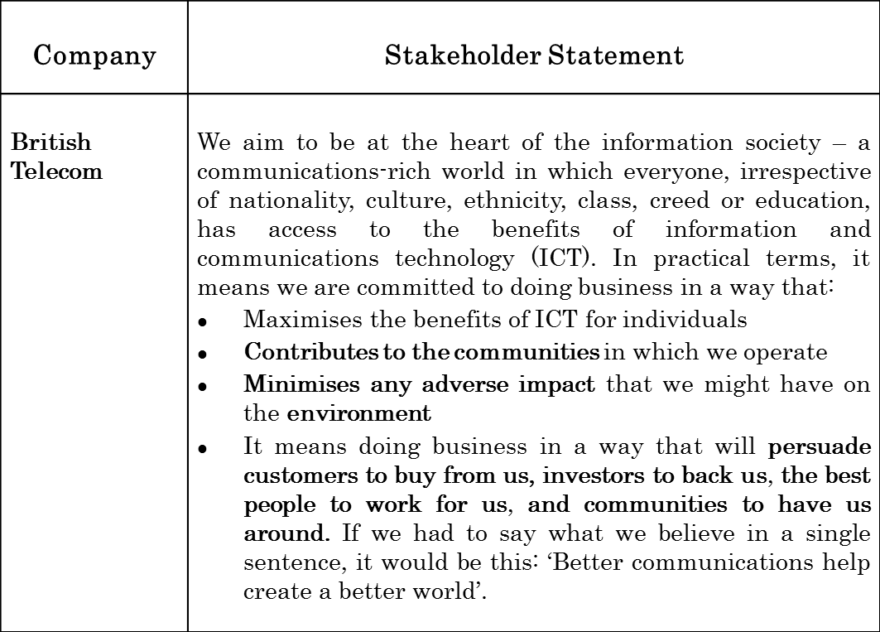
BUSINESS OBJECTIVES INCORPORATING STAKEHOLDER CONCEPT

Slide 116
STAKEHOLDER ENGAGEMENT
Demands from stakeholders on :
  Corporate governance and Business Ethics
  Environmental performance,
  Workplace health and safety
  Human rights
  Impact on communities
  Reporting transparency.
Stakeholder views to be considered for deciding future strategy
Stakeholders to be engaged in a dialogue to facilitate smooth functioning of the firm.

Slide 117

STAKEHOLDER ENGAGEMENT : ITC
Providers of financial capital
Customers
Employees
Supply chain partners
Farmers
Government and Regulatory Authorities
Local Communities
Civil Society
Media

Slide 118
Various Key Stakeholders, Mode of Engagement, Key Sustainability Concerns and Initiatives Taken by ITC
Stakeholder & Mode of Engagement | Key Sustainability Concerns | Initiatives by the Company
Customers: Market surveys Personal contacts/visits Personalised lifestyle privilege programme Customer satisfaction surveys Joint development and improvement projects Key account management Multi-level interfaces at dealer-customer-end use | Fair and competitive pricing Product/service quality Adequate information on products Product/ service availability Timely delivery of product/service Maintenance of privacy/ confidentiality | Robust Quality Assurance systems, supported by process innovations, adoption of green technology, lean management, six sigma and TPM, for providing high quality cost competitive products and services Significant investments in R&D to develop newer products
Supply chain partners: Manufacturers’ Meet Vendor Meets Pre-agreement negotiations Agreements for all procurement activities | Knowledge and infrastructure support Regular communication and updates on business plans Inclusion of local medium and small scale enterprises in vendor base Competency development of local vendors | Policies, processes and best practices that ensure that procurement activity is conducted in an open, transparent and non discriminatory manner Competitive pricing Timely payment and changes or cancellation of orders in line with terms and conditions agreed upon

Slide 119
DYNAMIC ENVIRONMENT OF BUSINESS
Markets and businesses gone global
Viable and long-term business growth no longer separate from well-being of societies
Staying aloof no longer a choice .
Building a culture of responsibility and becoming more actively engaged in finding solutions to broader societal challenges is one way forward.

Slide 120
Lets Sum Up
Business activities impact the social environment, so managers need to understand this relationship and their the impact on society.
Systems Theory helps managers to look at organisations from a broader perspective.
Ownership Theory of the Firm stresses that the primary duty of a firm is to maximise shareholder’s profits.
Stakeholder Theory states that the firm should act in the interest of all its stakeholders.
Stakeholders can be divided into two: primary stakeholders – who have direct stake in a company like employees, suppliers, local communities, business partners etc. and secondary stakeholders – who don’t have direct stake like media, social groups, civic bodies etc.
While deciding future strategies-stakeholders views must be taken into consideration.

Slide 121


